Slide 1


SAP BTP Training
Cloud Foundry Training

Slide 2

DISCLAIMER
The training content and delivery of this presentation is confidential, and cannot be recorded, or copied and distributed to any third party, without the written consent of Anubhav Trainings

Slide 3

LEARNING OBJECTIVES
Fiori App
CI/CD using Jenkins
Authentication v/s Authorization
Process of implementation
Obtain JWT and test
What is Node JS
Development tools
Java Script Basics
Functions in JS
Node Package Manager
Sequence Diagram – Asynchronous
Access Global Node Modules
Steps to initialize node project
Node with git
Middleware

Slide 4
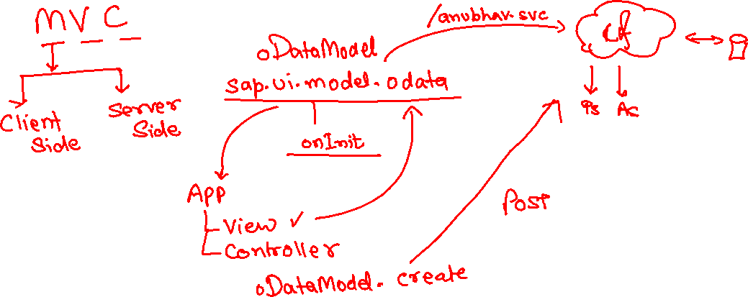
Fiori App on ODATA
In the last session we have enabled the OData and OData development. Now, we will develop the Fiori app using the odata service.
www.anubhavtrainings.com

Slide 5
Jenkins Steps
Steps
Download and install Jenkins https://www.jenkins.io/download/
Set JAVA_HOME, M2, M2_HOME, JENKINS_HOME Environment Variables
It will run automatically as a window service on port 8090 - http://localhost:8090/
Default user and password is admin / admin
Go to manage Jenkins → Manage Plugins
Maven Integration plugin
GitHub
Cloud Foundry Plugin
www.anubhavtrainings.com

Slide 6
Authentication v/s Authorization
Authentication – Are you a valid user? User credentials validated. – user Account
Authorization – What is user allowed to access with the app?
XSUAA – User Account and Authorization
This is a in-built component inside of SAP CF
It is responsible to control the User account and Authorization
In Cloud Foundry, we can use a modular concept for managing Authorizations
We need to register our Scopes, Role Templates related to the app with XSUAA
Communicates with IDP
Issues JWT Tokens which is then injected in our App which has information about Scope(Role) user has
Scope
(Role)
Role Templates
Role Collections
* *
* *
* *
www.anubhavtrainings.com

Slide 7




















Slide 8

IdP – Identity Provider
Our CF APP
JWT
manually
xsuaa
www.anubhavtrainings.com

Slide 9
Process Of Implementation
Create a New backing service instance for XSUAA
While creating this instance we need to pass our Role Configuration (JSON) = xs-security.json
Documentation for making xs-security file
https://help.sap.com/viewer/4505d0bdaf4948449b7f7379d24d0f0d/2.0.03/en-US/6d3ed64092f748cbac691abc5fe52985.html
We need to bind our app with this backing service
If we use Java, we need to add a security module (Spring) to restrict access to end points
https://github.com/SAP/cloud-security-xsuaa-integration
Deploy and Test our app
{
"xsappname": "07springodata",
"tenant-mode": "dedicated",
"scopes": [{
"name": "$XSAPPNAME.AnubhavDisplay",
"description": "To Display vendor data"
},
{
"name": "$XSAPPNAME.AnubhavEdit",
"description": "To Create new vendor data"
}
],
"role-templates": [{
"name": "Viewer",
"description": "View, Vendor Details",
"scope-references": [
"$XSAPPNAME.AnubhavDisplay"
]
},
{
"name": "Editor",
"description": "Edit and Create new Vendor Details",
"scope-references": [
"$XSAPPNAME.AnubhavEdit"
]
}
]
}
www.anubhavtrainings.com

Slide 10
Obtaining JWT Token from XSUAA
Create a POST call to XSUAA service to obtain JWT token
Type: POST
URL : <url from CF>/oauth/token
Body – x-www-url-encoded
(examples)
client_id - <get from cf>
client_secret - <get from cf>
username – <pass your CF email id>
password – <your CF password>
grant_type – password
response_type – token
2. Call your Service - https://07springodata-smart-wolverine-rk.cfapps.eu10.hana.ondemand.com/anubhav.svc
Type: GET
Headers –
Authorization : Bearer <token which we obtain in last step>
Content-Type : application/json
www.anubhavtrainings.com

Slide 11
What is Node JS
Node is an open-source, Cross Platform, Java script runtime environment and used for executing Java Script code outside web browser.
Node.js is a great web framework for beginners because it works great for data-intensive applications, like streaming and real-time apps, and Node.js makes it east to start building backend.
Applications
Build Application Logic
Web Server
Send Email
DB lookups
Automations
Outputs
Host Web Apps
Server
Java
ABAP
Client
Java Script
Node JS
Java Script
www.anubhavtrainings.com

Slide 12
Development Tools?
Step 1: Install your dev tool
BAS – SAP Businesss Application Studio
Local
VSCode – Free tool provided by Microsoft
It gives thousands of plugins which we can install to make life of a developer easy.
https://code.visualstudio.com/download
Step 2: Install Node JS
Download and install node js - https://nodejs.org/en/
Test if its available
node -v
www.anubhavtrainings.com

Slide 13
Funda Fox
JS is a case sensitive programming language
Every statement ends with semi-column
Every variable or function follows JS naming convention (camel-case). The first letter is small and next consecutive word, first letter is capital.
Iloveindia → iLoveIndia mylifeiscool → myLifeIsCool
An array is a collection of values, each value is an item of an array. The index of first item always starts with zero (0)
Objects are like structures to contain multiple fields of different kinds
{ “propName” : value , “PropertyName” : value …. }
Java Script Object Notation – JSON https://jsonlint.com/
Array
Item 0
Item 1
Item …
100001 | Anubhav | 5000 | USD
www.anubhavtrainings.com

Slide 14
Functions
There are 2 types of functions
Namedfunction
var functioName = function(params…){
--code
return ;
}
Anonymous function
function(params…){
return ;
}
www.anubhavtrainings.com

Slide 15
NPM – Node Package Manager
NPM For Node JS = maven For Java
package.json = pom.xml
The world’s Largest Software Registry (Library)
This registry contains over 8.5mn code packages.
Open-source developers usage npm to share software.
Many organizations also use npm to manage their development – SAP - @sap
https://www.npmjs.com/
JS is asynchronous Non Blocking Programming language. Also is an event driven programming language.
Server
Node JS
Client
Mobile, Browser
Port
www.anubhavtrainings.com

Slide 16
Sequence Diagram
UI
Module
Synchronous – Java, ABAP, C, C++
w
async
Util (in-built)
ASynchronous – JavaScript
Callbacks
Promise
www.anubhavtrainings.com

Slide 17
Access Global Node JS Modules
The command to download the modules from NPMJS.com is
npm install modulename
Keep the module within the project
Keep the module globally in your system so all the projects can share it ➔ npm install –g <modulename>
If there is a utility, command line tools we install them globally
package.json
project
project
project
local
module
global
global
Package.json file
Information about our project name, author, version
All the dependencies required by this node project
When we deploy our project in another system/machine we can use npm install command
module
www.anubhavtrainings.com

Slide 18
Steps to initialize a fresh node project
Run command npm init – Creates a new node project
Answer simple questions and project gets created
As we mentioned that index.js is going to be my starring file, lets create the same
We can just add some code to index.js
To test our first node project, we can use a command called node .
Phase 2 – Create a webserver and microservice using ‘express’
Install express module and add that as dependency also to our project npm install express –save
You can check package.json and you will find dependencies
Use express module to create web server (refer index.js file)
Exercise:
Prepare a sample JSON payload for demo vendor data, and return that with endpoint /vendors
Create a new end point with /vendor/:id and just check in a collection of vendors if there is a vendor with this id passed by browser, and return that single vendor record
https://stackoverflow.com/questions/39632667/how-do-i-kill-the-process-currently-using-a-port-on-localhost-in-windows
www.anubhavtrainings.com

Slide 19
Node with git
Git HUB
Project
package.json
node_modules
www.anubhavtrainings.com

Slide 20
Middleware
We can include extra functionality to our express server as middleware. There are many usage of adding middleware.
Client
middleware
/vendors
Req
/customer
/orders
ppp.use(middlewarename)
https://yeoman.io/generators/
Exercise: Deploy our Node JS app to CF by adding manifest.yml and test the entire app
Check authorization
Accept special payloads json
Add security
…
www.anubhavtrainings.com

Slide 21
Access Global Node JS Modules
The command to download the modules from NPMJS.com is
npm install modulename
Keep the module within the project
Keep the module globally in your system so all the projects can share it ➔ npm install –g <modulename>
If there is a utility, command line tools we install them globally
package.json
project
project
project
local
module
global
global
Package.json file
Information about our project name, author, version
All the dependencies required by this node project
When we deploy our project in another system/machine we can use npm install command
module
www.anubhavtrainings.com

Slide 22
Steps to initialize a fresh node project
Run command npm init – Creates a new node project
Answer simple questions and project gets created
As we mentioned that index.js is going to be my starring file, lets create the same
We can just add some code to index.js
To test our first node project, we can use a command called node .
Phase 2 – Create a webserver and microservice using ‘express’
Install express module and add that as dependency also to our project npm install express –save
You can check package.json and you will find dependencies
Use express module to create web server (refer index.js file)
Exercise:
Prepare a sample JSON payload for demo vendor data, and return that with endpoint /vendors
Create a new end point with /vendor/:id and just check in a collection of vendors if there is a vendor with this id passed by browser, and return that single vendor record
https://stackoverflow.com/questions/39632667/how-do-i-kill-the-process-currently-using-a-port-on-localhost-in-windows
www.anubhavtrainings.com

Slide 23
Node with git
Git HUB
Project
package.json
node_modules
www.anubhavtrainings.com

Slide 24
Middleware
We can include extra functionality to our express server as middleware. There are many usage of adding middleware.
Client
middleware
/vendors
Req
/customer
/orders
ppp.use(middlewarename)
https://yeoman.io/generators/
Exercise: Deploy our Node JS app to CF by adding manifest.yml and test the entire app
Check authorization
Accept special payloads json
Add security
…
www.anubhavtrainings.com

Slide 25

Summarize
LET’S SUMMARISE!

Slide 26

Summarize
End of Day 9

Slide 28


We’re committed to empower you to be
#FutureReady
through powerful training solutions.
We build the workforce of the future.
250+
Corporate Clients
30,000+
Learners Trained
25000+
Learners Placed
FREE WEBINARS
Sign up for free webinars with industry experts every fortnight!
Enroll Now!
Contact us today!
https://anubhavtrainings.com

